Slide 1
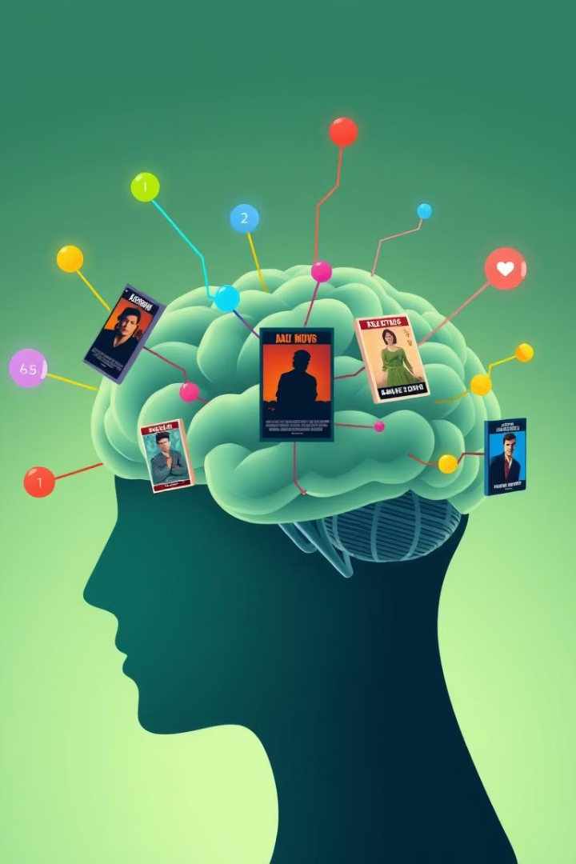
Manochitram: Movies-That Match Your Mood
Manochitram revolutionizes movie recommendations by prioritizing your mood and age. Using advanced sentiment analysis and a vast movie database, we provide perfectly tailored film suggestions to match your emotional state.
Done by :
D. Sanjana (1602-23-737-044)
B.Shiva Sai (1602-23-737-049)
G. Srinithi (1602-23-737-304)
Notes:
1

Slide 2
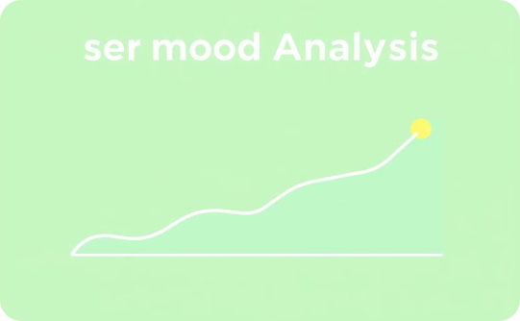
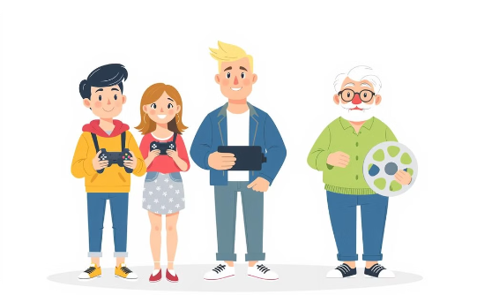
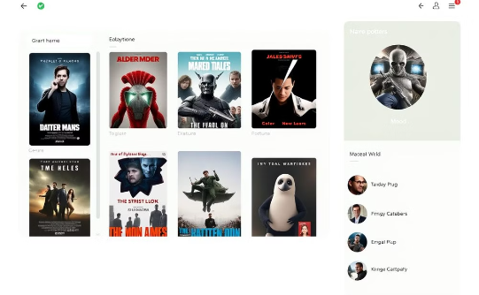
Abstract
Mood Analysis
Age-Based Preferences
Movie Recommendations
Manochitram leverages advanced sentiment analysis to gauge user mood.
It incorporates age-based preferences to tailor recommendations.
Manochitram maps emotional states to suitable film genres and presents a user-friendly interface.
Utilizing the TMDB API for movie information and an SQLite database for data storage.
Notes:
2

Slide 3
INTRODUCTION
Recommendation Systems
Definition: A software application that provides personalized suggestions for products, services, or content.
Relevance to This Project: While most recommendation systems rely on user history or general preferences, this project innovates by incorporating user mood and age for more personalized and contextually relevant suggestions.
Sentiment Analysis
What is Sentiment Analysis? A Natural Language Processing (NLP) technique to determine the sentiment (positive, neutral, or negative) expressed in text. In this project, it's used to interpret user mood from text inputs.
How It Works in the Project: The TextBlob library analyzes user input (e.g., "I am feeling happy"). This sentiment is then classified and mapped to movie genres:
Positive → Comedy movies
Neutral → Action movies
Negative → Drama movies
Notes:
3

Slide 4
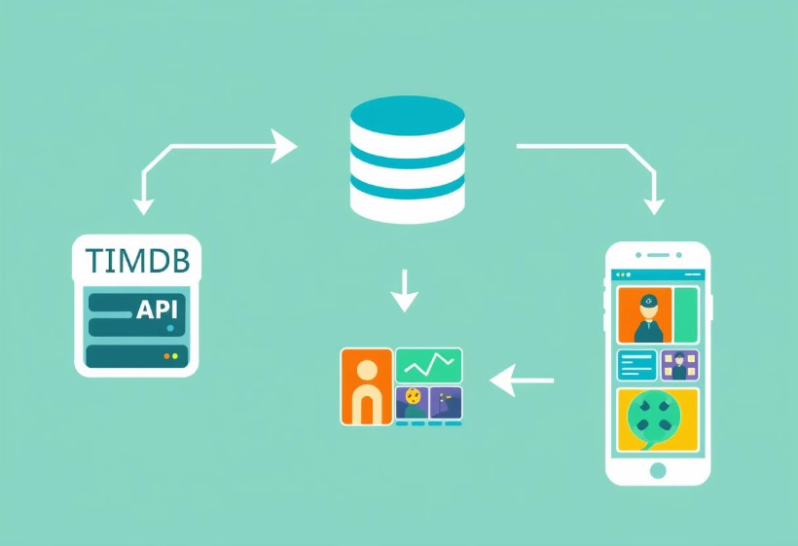
INTRODUCTION
Data Retrieval and Storage
Real-Time Data Retrieval
The system uses the TMDB API to fetch up-to-date movie information (titles, genres, ratings, poster images), ensuring current and diverse recommendations.
Data Storage
An SQLite Database stores user details (name, age, gender, mood) and movie recommendations (title, genre, ratings), allowing persistence for future reference or analysis.
Notes:
4

Slide 5





Manochitram's Design
User Input
The user provides their current mood and age preferences, setting the stage for personalized recommendations.
Sentiment & Age Mapping
The system analyzes the user's mood and age preferences, matching them with relevant movie categories.
TMDB API Request
Manochitram queries the TMDB API for movies that fit the user's mood and age criteria, ensuring a wide range of options.
Database Interaction
The system retrieves movie details and recommendations from the SQLite database, ensuring efficient and personalized results.
Movie Recommendations Display
Manochitram displays a personalized list of movie recommendations based on the user's input and database information.
Notes:
5

Slide 6
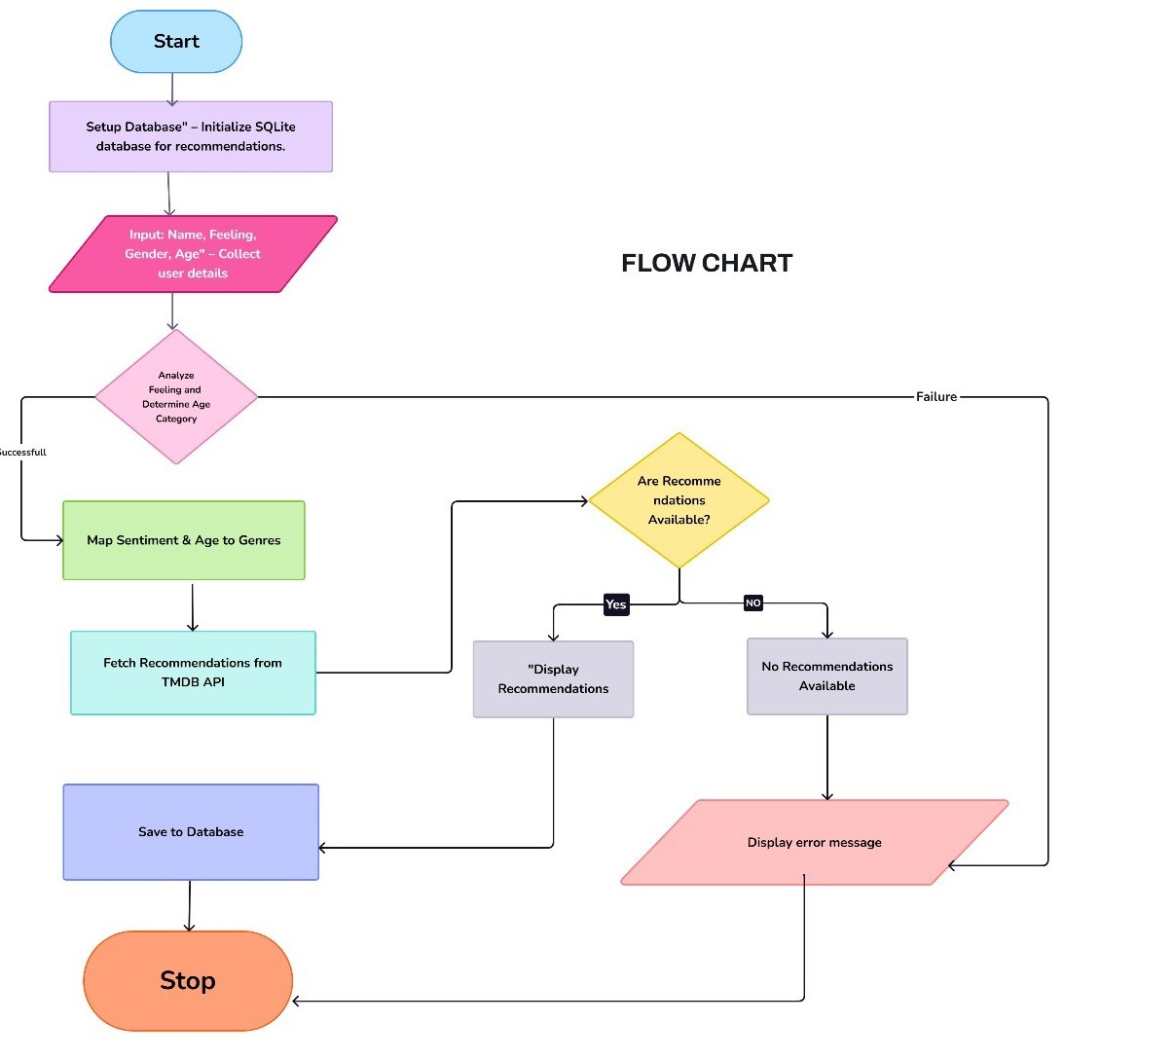

Slide 7


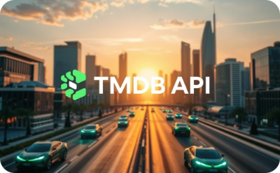

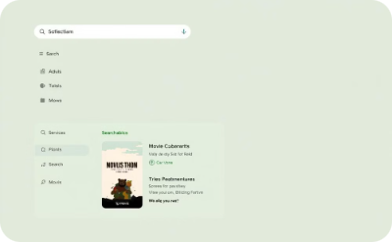
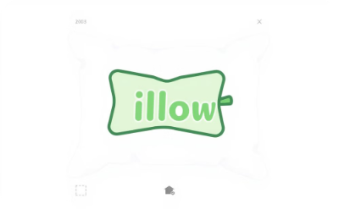
The Technology Behind Manochitram
Language: Python
Sentiment Analysis: TextBlob
Movie Data: TMDB API
Database Management: SQLite
User Interface: Tkinter
Image Handling: Pillow
Notes:
7

Slide 8
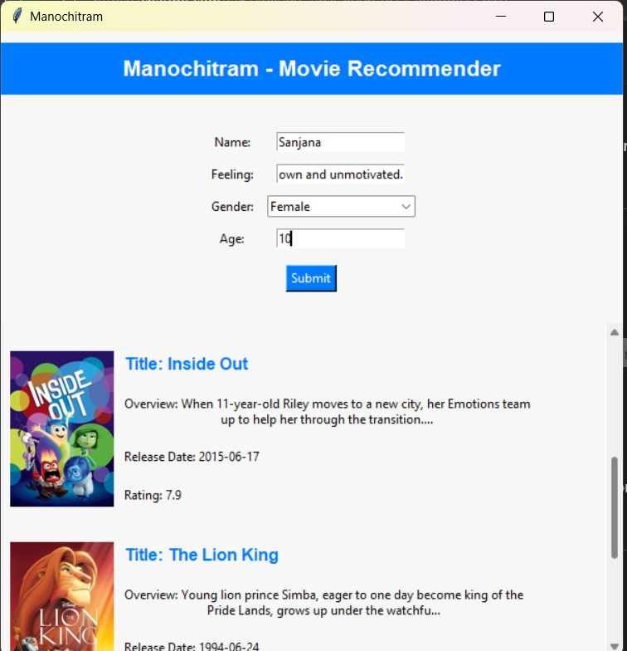
A Look at Manochitram in Action
r
Notes:
8

Slide 9
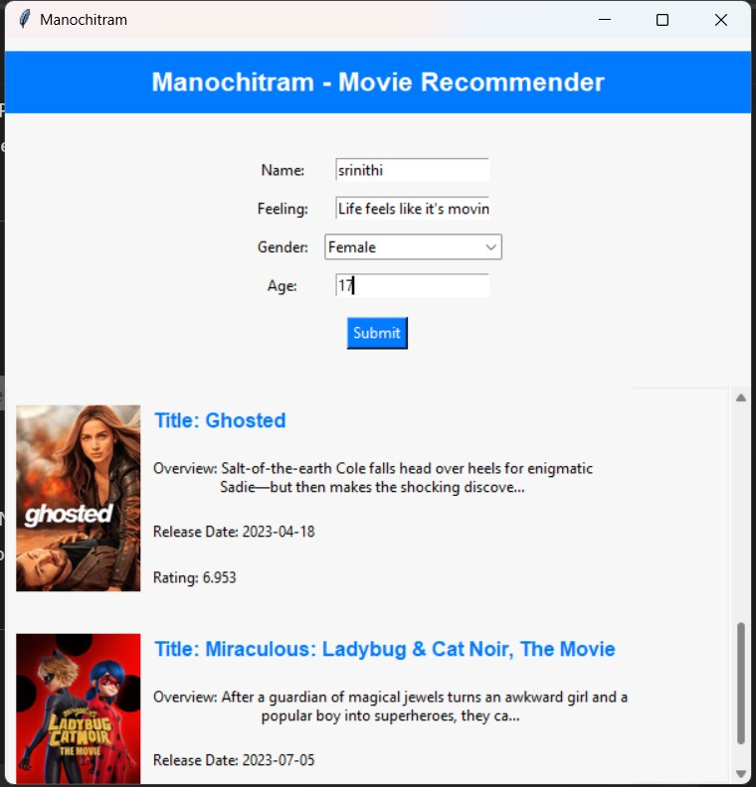

Slide 10
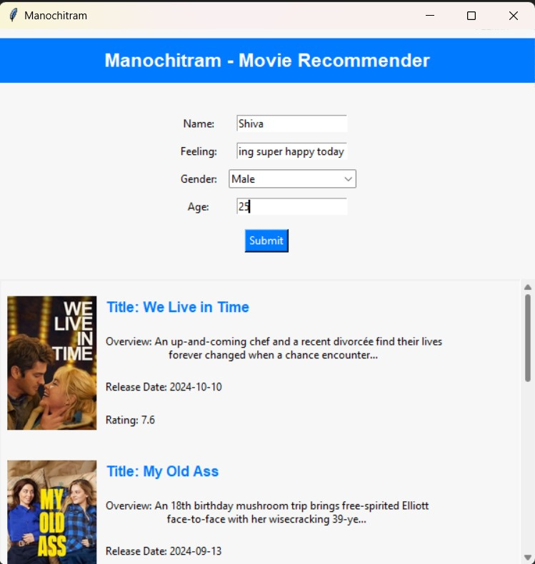

Slide 11
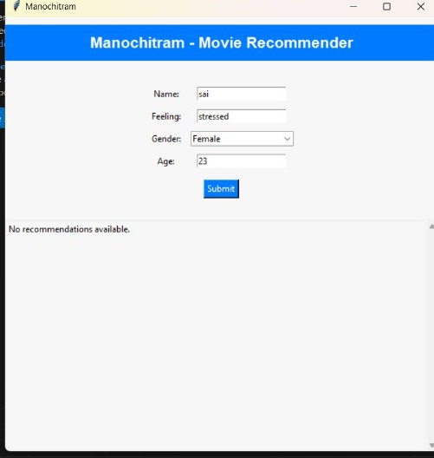

Slide 12
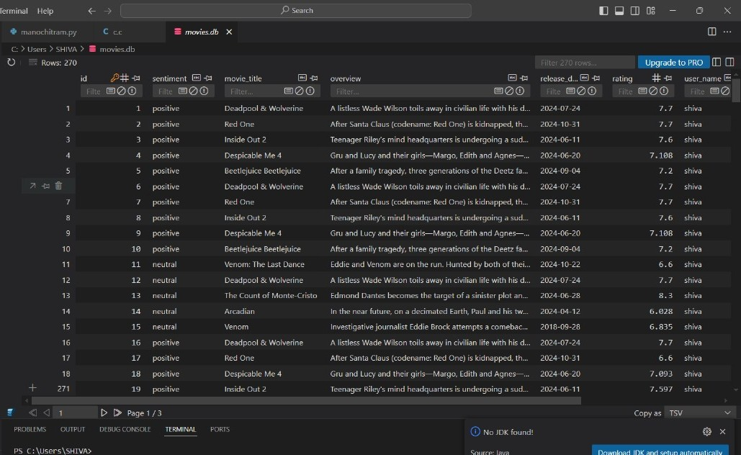

Slide 13

CONCLUSION
Successful System
Data Integration
User-Friendly Interface
This project successfully developed a personalized movie recommendation system that integrates sentiment analysis and age-based categorization for enhanced accuracy.
Real-time movie data was efficiently retrieved using the TMDB API and recommendations were stored persistently in an SQLite database.
A user-friendly Tkinter GUI facilitates seamless user interaction and dynamic display of recommendations.
FUTURE WORK
Enhance Recommendation Accuracy
Expand Platform Accessibility
Direct Streaming Integration
Integrate advanced algorithms such as collaborative filtering or content-based filtering to further improve recommendation accuracy.
Migrate the system from a desktop application to a web-based or mobile platform to increase accessibility and reach a wider audience.
Integrate directly with popular streaming platforms like Netflix, Prime Video, or IMDb, providing users with direct links to view recommended movies.
Implement user feedback mechanisms to enable continuous learning and refinement of the recommendation system.
Notes:
12

